Slide 1
Introduction to Cryptography
Cryptography Day 1

Slide 2
Today’s Objectives
By the end of class, you will be able to:
Articulate the goals of cryptography.
Discuss modern encryption standard, particularly AES.
Differentiate between substitution and transposition ciphers.
Explain how textual data can be represented in binary, octal, and hex.
Determine the output of the XOR operation given two input bitstreams.
Compare and contrast symmetric and asymmetric cryptography
Use OpenSSL to encrypt data with a symmetric key.

Slide 3
Introduction to Cryptography

Slide 4
Why Cryptography Matters
Threat Actors
Sender
Receiver
Secure Channel with Data Exchange
Information is often the most prized asset of individuals and organizations.
Ensuring information can be stored, transmitted, and received securely is a central responsibility of modern security professionals.
Notes:
Image Recreated

Slide 5
Goals of Cryptography
Introducing the P.A.I.N Framework:
Privacy
Authentication
Integrity
Non-repudiation

Slide 6
Goals of Cryptography
We’ll look at each of these pillars in more detail later, but here is a brief overview of how each goal protects data:
Privacy ensures it is accessible by the intended recipients.
Authentication ensures it is sent from the claimed sender.
Integrity ensures it can’t be intercepted and modified in flight.
Non-repudiation verifies if an individual did or did not send data.

Slide 7
Goals of Cryptography
Each pillar is supported by specific methods and tools.
Privacy is provided through encryption.
Authentication is provided through digital signatures.
Integrity is checked through hashes.
Non-repudiation is supported through signatures and certifications.

Slide 8
Student Activity:
Key Terms and Orientation
In this activity, you will familiarize themselves with some key terms in cryptography.
15 Minutes

Slide 9
Key Terms and Orientation
Instructions:
1. Use the Cryptography Terminology resource and Wikipedia to define and provide an examples for each of the following terms:
Privacy
Authenticity
Integrity
Non-Repudiation
2. Define the following key terms, and provide an example of each if you can:
Plaintext Ciphertext Cryptography Code Bit Cipher Encryption
Key Encryption Decryption Symmetric-Key Cryptography Asymmetric-Key Cryptography
Hash Signature Checksum

Slide 10
Key Terms and Orientation

Slide 11
Modern Cryptosystems and Standards

Slide 12



Modern Cryptosystems and Standards
Encryption, Decryption and Keys
Encryption is the process of obfuscating a plaintext by converting it into ciphertext by using a special values called a key along with a fixed set of rules.
Decryption is the process of turning a ciphertext back into plaintext.
The key must remain SECRET! Once the key is known, you can easily decrypt messages by applying the rules in reverse.

Slide 13
Encryption and decryption must be complex enough to provide a strong security but also simple enough to perform quickly with the key.
The Cryptography Trade-off

Slide 14
Ensuring Privacy and Confidentiality
Data at Rest
Data in Motion
Static data, such as that stored on a hard disk or a database.
Prevents it from being intelligible to prying eyes
Data moving between machines on the network, such as your computer and YouTube, or your phone and the cell tower.
More complicated than protecting data at rest

Slide 15
Ensuring Privacy and Confidentiality
Data at Rest
Data in Motion
Protected by encrypting data on hard drives and in databases and storing sensitive data in multiple separate locations.
Tools:
Using AES to encrypt data
Storing AES-encrypted data in multiple database.
More complicated, as at least two machines are exposed to the data.
Must be able to encrypt / decrypt quickly
Tools:
Using AES in combination with RSA to protect communications on the web with TLS
Using SSH to encrypt remote shell sessions

Slide 16



Ensuring Authenticity
With authenticity, a user can verify the identity of a data source.
Attackers can send encrypted data claiming to be someone they’re not
Encryption will provide little protection in these cases.
With the use of asymmetric cryptography, digital signatures are the main tool used to verify the authenticity of a message. Then, we can ensure:
Emails came from the claimed sender.
Downloaded files come from the correct server.

Slide 17

Ensuring Integrity
We need to know that the data we are sharing is the correct information.
Hashing can be used to verify the integrity of data by:
Verifying that a file downloaded from a server is in fact the file on the
server, as opposed to an attacker intercepting and modifying the file.
Verifying that data has made it across the wire without corruption.
Client requests data from a server
Server sends the hash digest of data to the client
Server sends the requested data
Server hashes data received and compares to digest from server
If digest matches, the data hasn’t been corrupted

Slide 18



Ensuring Non-Repudiation
Ensuring that a message is inextricably linked to a sender.
If Bob sent a nasty memo to an entire department, non-repudiation ensures that he can’t scapegoat someone else.

Slide 19
Today’s de facto standard of symmetric key algorithm is AES.
Developed through community collaboration led by the National Institute of Standards and Technology.

Slide 20
Activity: DES Death March
In this activity, you will research the NIST competition model then answering the corresponding questions.
Instructions sent via Slack
15 Minutes

Slide 21
DES Death March

Slide 22
Checkpoint:
By the end of class, you will be able to:
Articulate the goals of cryptography.
Discuss modern encryption standard, particularly AES.
Differentiate between substitution and transposition ciphers.
Explain how textual data can be represented in binary, octal, and hex.
Determine the output of the XOR operation given two input bitstreams.
Compare and contrast symmetric and asymmetric cryptography
Use OpenSSL to encrypt data with a symmetric key.

Slide 23

The Key Concept of Cryptography
Plaintext
Ciphertext
Encryption
Readable Message, File or Data
Encrypted Message, File or Data
Key(s)
Decryption
A key the piece of information / parameter that specifies
how plaintext should be transformed into ciphertext
and vice versa.
Notes:
Key: Shutterstock ID 1085147084

Slide 24
Do we want an incredibly strong cipher that’s hard to compute and difficult to decrypt?
OR
Do we prefer an average cipher that is faster.
The Cryptography Trade-off

Slide 25
Ciphers and Keys

Slide 26
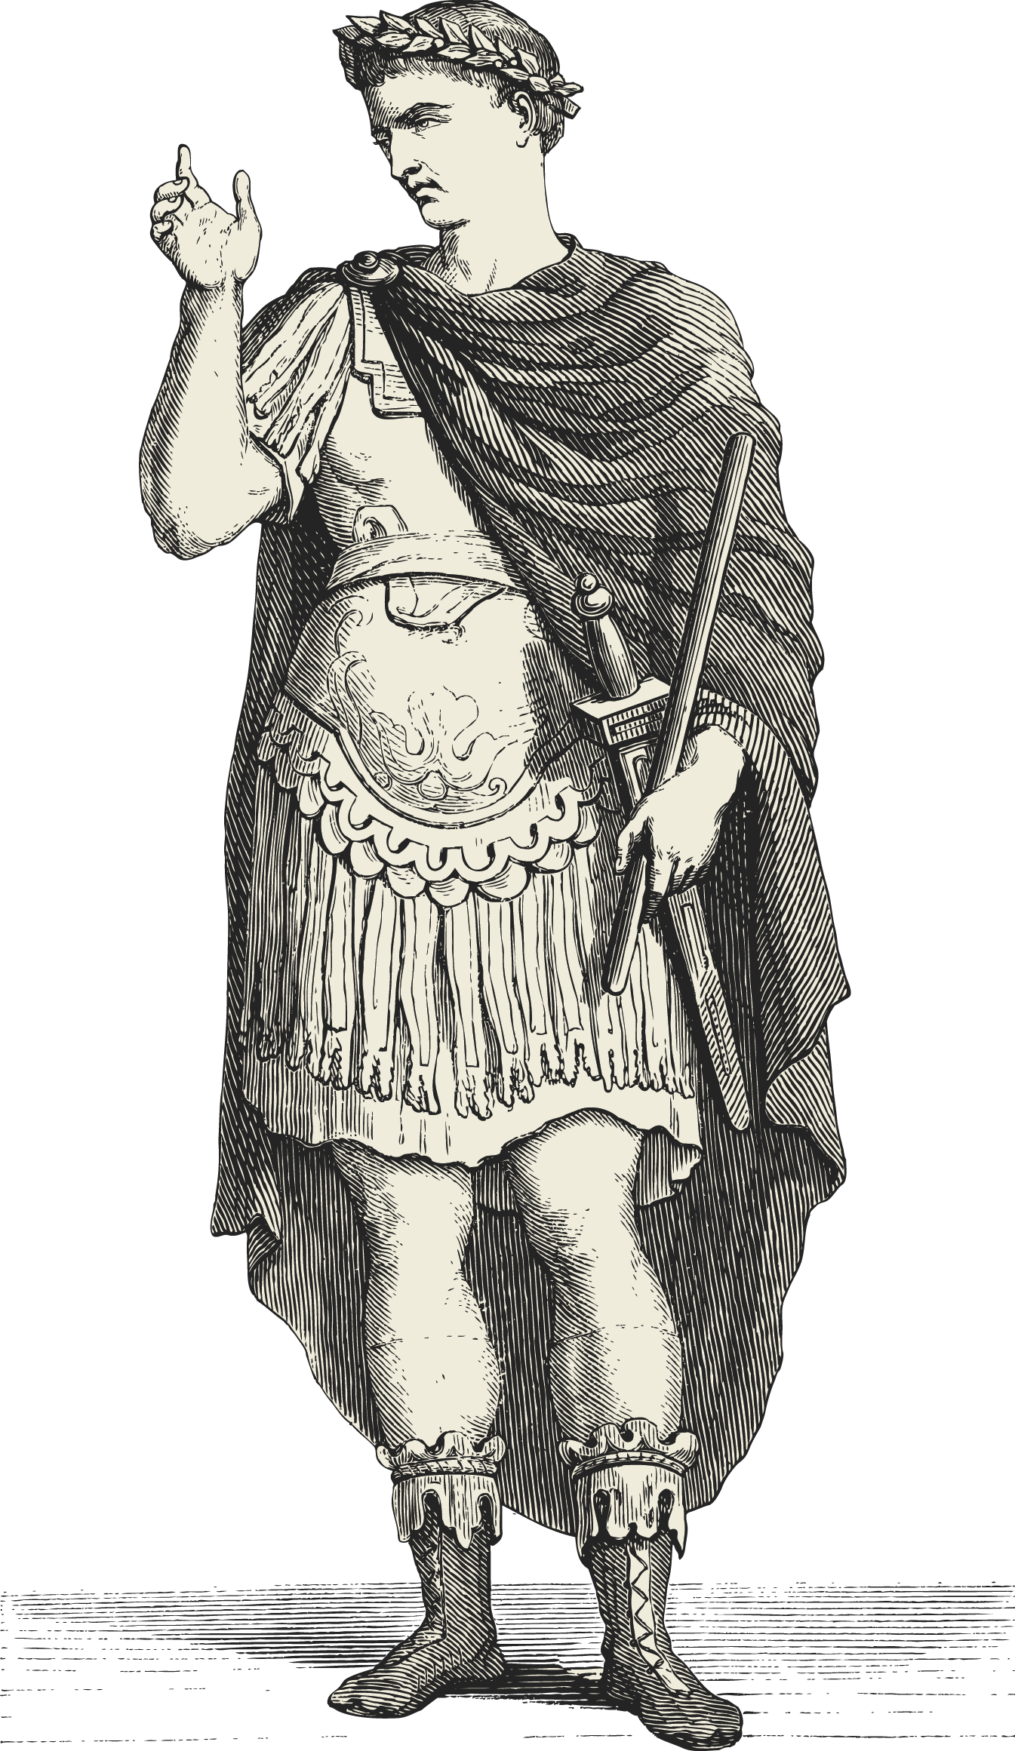
The Ceasar Cipher
They Shall Never Crack My Code!
One of the best known historic encryption techniques/
A simple substitution cipher in which a message is shifted a number of letters down the alphabet according to a key.
Sender:
Writes a Message
Selects a Key
Encodes Message
Recipient:
Receives Message
Uses known Key
Decodes Message
Notes:
Caesar: Shutterstock ID 92626915

Slide 27
How the Caesar Cipher Works
Original
Key = 2
A
B
C
D
E
F
G
H
I
J
A
B
C
D
E
F
G
H
I
J
Encoded
The Caesar Cipher works by shifting letters a set number (key value) of indices from the original position.
Example for Key = 2:
“I HID A CAB” → “K JKF C ECD”
“A BAD DAD” → “C DCF FCF”
Notes:
Diagram recreated

Slide 28
Transposition Ciphers
Transposition Ciphers are permutations that break messages into equal sized blocks and re-arrange the letters to a fixed rule.
Permutation is simply a rearrangement of a sequence of letters.
hlleo is a permutation of hello
The following rule breaks an input into three blocks and replaces the 1st, 2nd, and 3rd letters of the block with the 3rd, 1st, and 2nd respectively.
|1 2 3|
E = | |
|3 1 2|

Slide 29
Activity: Simple Ciphers and Key Spaces
In this activity, you will practice using each of the classical ciphers discussed in the lecture.
Instructions sent via Slack.
13 Minutes

Slide 30
Cipher and Key Spaces

Slide 31
Character Encoding
and
Binary Representation

Slide 32
Letter ciphers are not compatible with the numerical representation of digital data.

Slide 33
Character Encoding is the process of representing letters as numbers in order to encrypt data on computers.

Slide 34
Character Encoding
Some forms of character encoding we’ll look at: ASCII
ASCII stands for the American Standard Code for Information Interchange.
It is used to represent computer-stored characters in a human-readable format.
Look down at you keyboards. Every character is part of ASCII system: Upper and lowercase letters, special characters (!@#$...), numericals (1,2,3,4…)
We can convert strings of comprehendable sentences into purely numerical strings.
Check out ASCII Table Chart

Slide 35
Character Encoding
Some forms of character encoding we’ll look at: Binary
Binary Number System is the numerical representation of computer data as 1’s and 0s
A is 65 in ASCII, but 65 is not intelligible to a CPU, so we change A to 65 and then 65 into 1s and 0s.
We can understand Binary if we examine it relative to the common decimal system:
Binary counts in 2s (2 base value) whereas Decimal counts in 10s (10 base value).
Numbers | In Decimal: | In Binary: | Binary Translated to Decimal
10 | 1 ten 0 ones | 1 two 0 one | 10 = 2 (1 × 2¹) + (0 × 2⁰)
11 | 1 ten 1 ones | 1 two 1 one | 10 = 3 (1 × 2¹) + (1 × 2⁰)
12 | 1 tens 2 ones | 1 two 2 ones | N/a (2 is not a character in binary)
100 | 10 tens 0 ones | 2 twos 0 ones | 10 = 4 (1 × 2²) + (0 × 2¹) + (0 × 2⁰)

Slide 36
Hexadecimal and Octal
Even though computers read in binary, it is not a very efficient representation of data
Hello is binary = 11010001100101110110011011001101111
Hexadecimal system is a more compact representation of binary data.
Hex uses 16 characters to represent the base value. In other words, it is a base 16 system
The base numbers range from 0-9 and then letters A-F represent 11, 12, etc.
(A = 11, B= 12, C =13 etc.)
If we count our fingers using the decimal system, we’d count 1 to 10.
If we count on our fingers using the hex system, we’d count 1 to F.
Hexadecimal numbers are written with a \x to indicate the following number is to be read as hex: \x10

Slide 37
Comprehending Hex
Hex uses 16 characters to represent the base value. In other words, it is a base 16 system
The base numbers range from 0-9 and then letters A-F.
Dec. | Hex. | Dec. | Hex.
0 | 0 | 8 | 8
1 | 1 | 9 | 9
2 | 2 | 10 | A
3 | 3 | 11 | B
4 | 4 | 12 | C
5 | 5 | 13 | D
6 | 6 | 14 | E
7 | 7 | 15 | F
Dec. | Hex. | Dec. | Hex.
16 | 10 | 24 | 18
17 | 11 | 25 | 19
18 | 12 | 26 | ?
19 | 13 | 27 | ?
20 | 14 | 28 | ?
21 | 15 | 29 | ?
22 | 16 | 30 | ?
23 | 17 | 31 | ?
What do you think comes next?

Slide 38
Comprehending Hex
Hex uses 16 characters to represent the base value. In other words, it is a base 16 system
The base numbers range from 0-9 and then letters A-F.
Dec. | Hex. | Dec. | Hex.
0 | 0 | 8 | 8
1 | 1 | 9 | 9
2 | 2 | 10 | A
3 | 3 | 11 | B
4 | 4 | 12 | C
5 | 5 | 13 | D
6 | 6 | 14 | E
7 | 7 | 15 | F
Dec. | Hex. | Dec. | Hex.
16 | 10 | 24 | 18
17 | 11 | 25 | 19
18 | 12 | 26 | 1A
19 | 13 | 27 | 1B
20 | 14 | 28 | 1C
21 | 15 | 29 | 1D
22 | 16 | 30 | 1E
23 | 17 | 31 | 1F
And after 1F?

Slide 39
Comprehending Hex
Hex uses 16 characters to represent the base value. In other words, it is a base 16 system
The base numbers range from 0-9 and then letters A-F.
Dec. | Hex. | Dec. | Hex.
0 | 0 | 8 | 8
1 | 1 | 9 | 9
2 | 2 | 10 | A
3 | 3 | 11 | B
4 | 4 | 12 | C
5 | 5 | 13 | D
6 | 6 | 14 | E
7 | 7 | 15 | F
Dec. | Hex. | Dec. | Hex.
16 | 10 | 24 | 18
17 | 11 | 25 | 19
18 | 12 | 26 | 1A
19 | 13 | 27 | 1B
20 | 14 | 28 | 1C
21 | 15 | 29 | 1D
22 | 16 | 30 | 1E
23 | 17 | 31 | 1F
Dec. | Hex. | Dec. | Hex.
32 | 20 | 40 | 28
33 | 21 | 41 | 29
34 | 22 | 42 | 2A
35 | 23 | 43 | 2B
36 | 24 | 44 | 2C
37 | 25 | 45 | 2D
38 | 26 | 46 | 2E
39 | 27 | 47 | 2F

Slide 40
The mechanics of conversion are not as important as simply knowing these systems are in place to represent and encode data.

Slide 41
Post-Encoding Check-up
Five = I got this!
Fist = Help!!!

Slide 42
Activity: Character-Encoding Scavenger Hunt
In this activity, you will complete a scavenger hunt by identifying the type of character encoding of the provided numbers, and then decoding it to find the next clue
Instructions sent via Slack
5 Minutes

Slide 43
Your Turn: Scavenger Hunt
Instructions
Convert the following into binary code:
57 65 6c 63 6f 6d 65 20 74 6f 20 74 68 65 20 73 63 61 76 65 6e 67 65 72 20 68 75 6e 74 21 20 47 6f 20 74 6f 20 74 68 65 20 66 6f 6c 6c 6f 77 69 6e 67 20 77 65 62 73 69 74 65 3a 0a 68 74 74 70 3a 2f 2f 77 77 77 2e 70 61 67 65 6f 72 61 6d 61 2e 63 6f 6d 2f 3f 70 3d 73 65 63 72 65 74 34
Hint: Copy and paste the above into Google and this should give you a list of results that will convert this code for you

Slide 44
Scavenger Hunt

Slide 46
Checkpoint:
By the end of class, you will be able to:
Articulate the goals of cryptography.
Discuss modern encryption standard, particularly AES.
Differentiate between substitution and transposition ciphers.
Explain how textual data can be represented in binary, octal, and hex.
Determine the output of the XOR operation given two input bitstreams.
Compare and contrast symmetric and asymmetric cryptography
Use OpenSSL to encrypt data with a symmetric key.

Slide 47
Bitwise Operators and XOR Cipher

Slide 48
Bits ‘n Bytes
Now we’ll dive into how encryption works in a digital setting.
Here is the binary representation for the letter “h”:
1101000
This is a bit.
A bit is each place of a binary string.

Slide 49
Bits ‘n Bytes
Now we’ll dive into how encryption works in a digital setting.
Here is the binary representation for the letter “h”:
1101000
This is a byte. Eight bits is a byte.

Slide 50
Bits ‘n Bytes
Now we’ll dive into how encryption works in a digital setting.
Here is the binary representation for the letter “h”:
1101000
All digital data is represented in terms of bits.
We can encrypt bits just like letters, with substitution and permutation.
Another crucial tool for encryption is XOR, which will cover in a moment.

Slide 51
Bitwise Operators
Bitwise operators take two binary numbers, compare them, and output a binary result based on specific conditions used to compare them.
X | Y | X & Y | X | Y | X^Y (XOR)
1 | 1 | 1 | 1 | 0
0 | 0 | 0 | 0 | 0
0 | 1 | 0 | 1 | 1
1 | 0 | 0 | 1 | 1
AND Output
OR Output
XOR Output
Input
Input

Slide 52
Bitwise Operator - AND
AND is the simplest bitwise operator.
X | Y | X & Y | X | Y | X^Y (XOR)
1 | 1 | 1 | 1 | 0
0 | 0 | 0 | 0 | 0
0 | 1 | 0 | 1 | 1
1 | 0 | 0 | 1 | 1
If both inputs have a 1 in the same place, then output is 1. Otherwise, output is 0
Example: 1100 & 0110 = 0100

Slide 53
Bitwise Operator - OR
OR is the opposite of AND.
X | Y | X & Y | X | Y | X^Y (XOR)
1 | 1 | 1 | 1 | 0
0 | 0 | 0 | 0 | 0
0 | 1 | 0 | 1 | 1
1 | 0 | 0 | 1 | 1
If either input has 1 in the slot, then output is 1. Otherwise, output is 0
Example: 1100|0110 = 1110

Slide 54
Bitwise Operator - ORX
XOR (Exclusive Or) is the main operator we’ll focu on for encrypting:
X | Y | X & Y | X | Y | X^Y (XOR)
1 | 1 | 1 | 1 | 0
0 | 0 | 0 | 0 | 0
0 | 1 | 0 | 1 | 1
1 | 0 | 0 | 1 | 1
If other inputs have a 1 in a slot, or if both inputs have 0 in a slot, output 0.
Otherwise, output 1.
Example: 1100^0110 = 1010

Slide 55
XOR Cipher
XOR can be used for encryption because it reversible.
X | Y | X^Y
1100 | 0110 | 1010
1010 | 0110 | 1100
A ^ B = C C ^ B = A
We can encrypt a number A, by using a key B, to produce the encoded data in C.
We can decrypt C by XOR-ing it with the key B, to retrieve the plaintext, A.

Slide 56
XOR vs AND / OR
XOR is irreversible without the knowing the key.
When applying the bitwise operator AND to two bitstreams, there's a 25% chance you'll get a 1.
When applying the bitwise operator OR to two bitstreams, there's a 75% chance you'll get a 1.
By contrast, XOR has a 50% chance of outputting a 0 or 1.

Slide 57
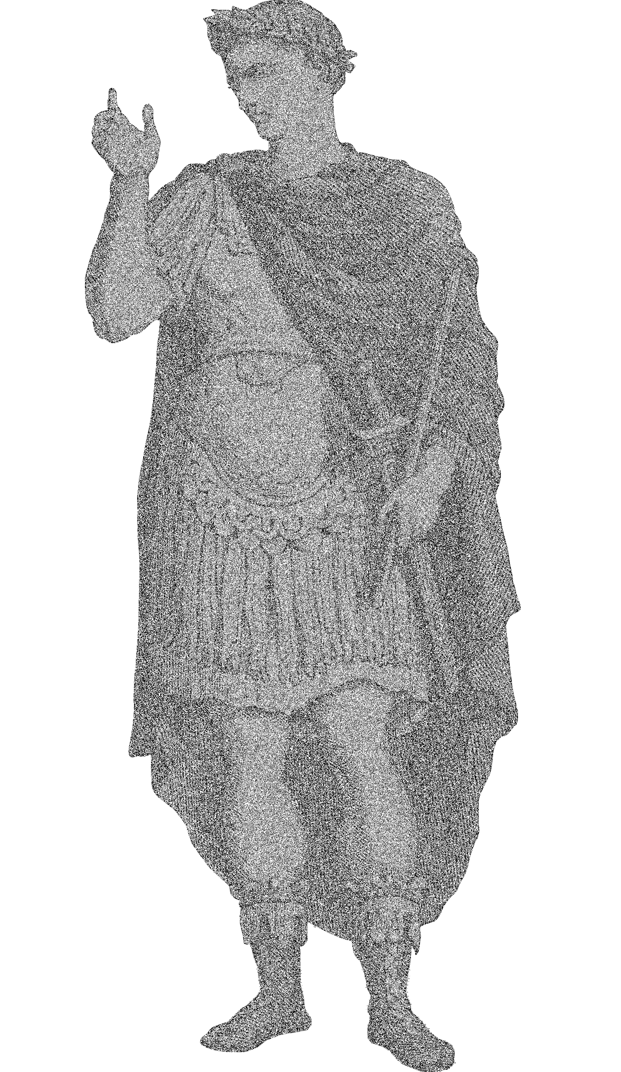
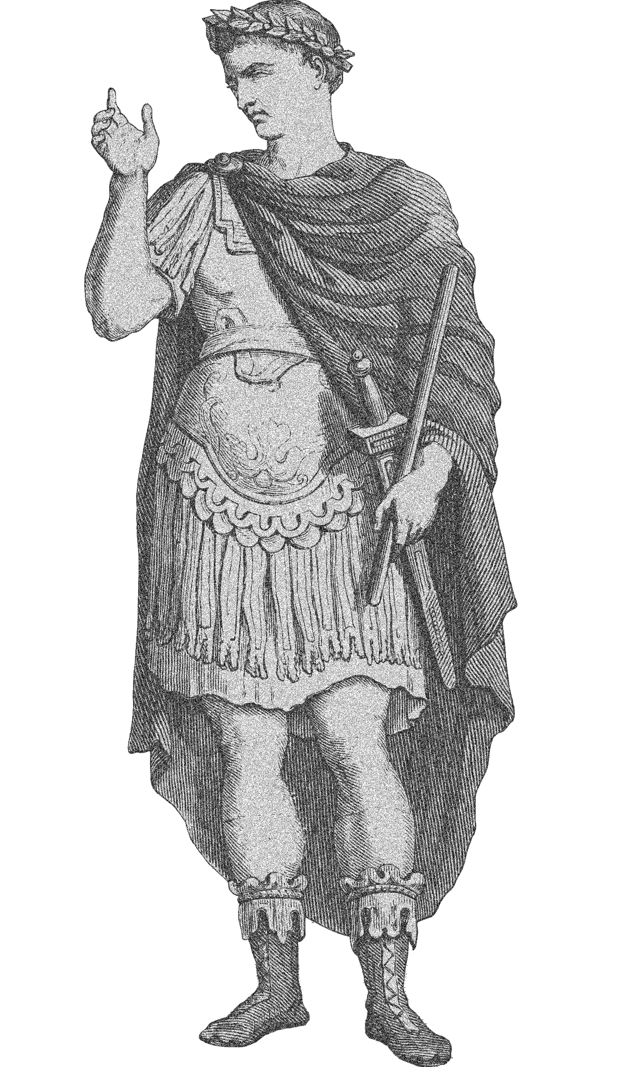
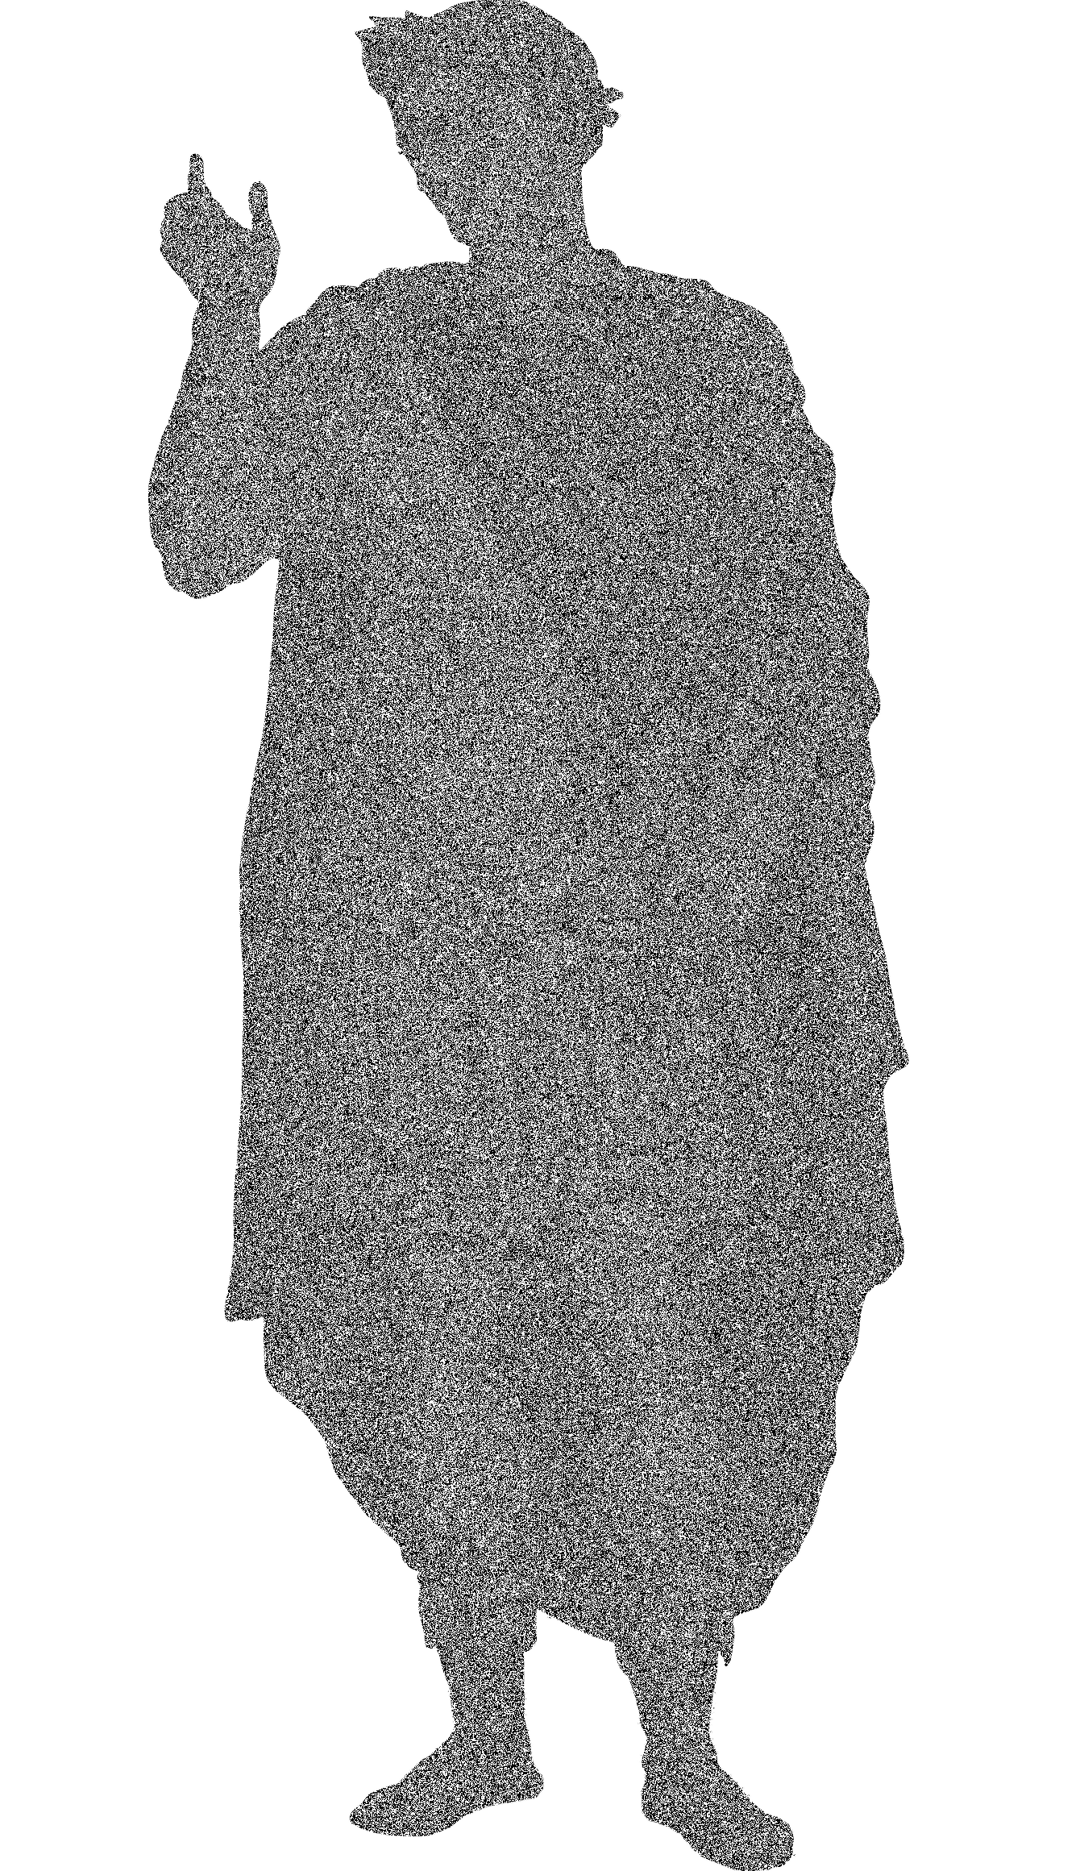
XOR vs AND / OR
AND
OR
XOR

Slide 58
Activity: XOR Cipher
In this activity, students will develop an intuition for the behavior of XOR and build truth tables for AND, OR, and XOR.
Instructions sent via Slack.
7 Minutes

Slide 59
Scavenger Hunt

Slide 60
Symmetric vs. Asymmetric
Cryptography

Slide 61

Symmetric-Key Algorithm
Symmetric-key algorithms are algorithms that use the same key to encrypt and decrypt.
Same Key
A$4h*L@9.7o71PLY202!bA)(!#&2910Go$@94^0#@
Encryption
Decryption
Plain Text
Plain Text
Cipher Text
Notes:
Recreated Diagram

Slide 62
Symmetric Encryption
The process:
Divide Data into Blocks (Transposition)
Perform a substitution on each block
Perform a permutation of the resulting substitution
The Key is XORed with the result permutation.
The process is repeated multiple times, and the blocks recombines create and encrypted whole.

Slide 63
Key Exchange
One key is required for each pair of people who want to share encrypted messages:
Alice, Bob, Eve, and Jane
Alice ⟷ Bob
Alice ⟷ Eve
Alice ⟷ Jane
Bob ⟷ Eve
Bob ⟷ Jane
Jane ⟷ Eve
Six different keys are required to share amongst four people.
Asymmetric encryption addresses this issue...

Slide 64

Asymmetric-Key Algorithm
Asymmetric-key cryptography (a.k.a public-key cryptography) uses two keys to encrypt and decrypt.
Different Keys
Public Key
Private Key
A$4h*L@9.7o71PLY202!bA)(!#&2910Go$@94^0#@
Encryption
Decryption
Plain Text
Plain Text
Cipher Text
Notes:
Recreated Diagram

Slide 65
Symmetric Vs. Asymmetric
Symmetric
Asymmetric
Faster
- / + Less Computationally intense
Key Exchange Problem
De facto standard is AES (Advanced Encryption Standard)
+ / - Computationally Intense
Easier to use with many people
Used to verify identity / authenticity via digital signatures
De facto standard is RSA (Rivest-Shamir-Adleman)

Slide 66
Activity / Facilitated Discussion:
Symmetric vs. Asymmetric
In this activity, you will look at four scenarios and determine whether symmetric or asymmetric is more appropriate.
Instructions sent via Slack.
7 Minutes

Slide 67
Checkpoint: Almost There!
By the end of class, you will be able to:
Articulate the goals of cryptography.
Discuss modern encryption standard, particularly AES.
Differentiate between substitution and transposition ciphers.
Explain how textual data can be represented in binary, octal, and hex.
Determine the output of the XOR operation given two input bitstreams.
Compare and contrast symmetric and asymmetric cryptography
Use OpenSSL to encrypt data with a symmetric key.

Slide 68
Symmetric Encryption with Open SSL

Slide 69
Encrypting Data with OpenSSL

Slide 70
Activity : Encrypting Data with OpenSSL
In this activity, you will use OpenSSL to encrypt data using AES.
Instructions sent via Slack.
5 Minutes

Slide 71
OpenSSL

Slide 72
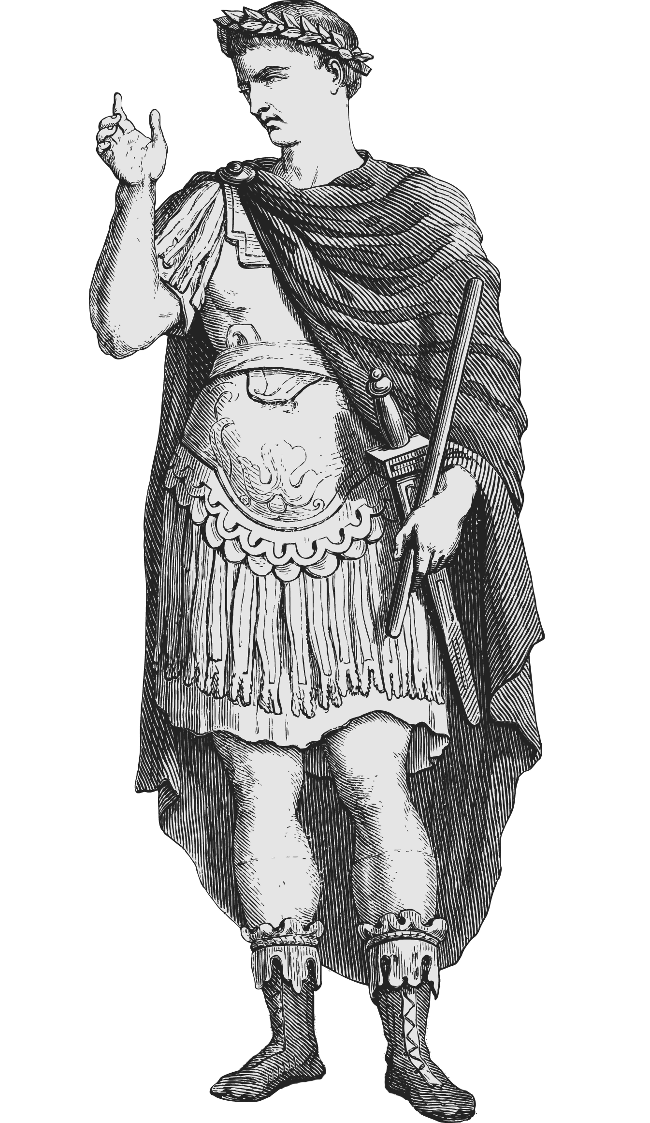
Checkpoint: Almost There!
By the end of class, you will be able to:
Any Questions?
Articulate the goals of cryptography.
Discuss modern encryption standard, particularly AES.
Differentiate between substitution and transposition ciphers.
Explain how textual data can be represented in binary, octal, and hex.
Determine the output of the XOR operation given two input bitstreams.
Compare and contrast symmetric and asymmetric cryptography
Use OpenSSL to encrypt data with a symmetric key.

